Slide 1
Python
Strings

Slide 2
Strings
A string is any text enclosed in quotation marks.
The following are all examples of strings.
“Please enter your name:”
“John Doe”
“182 D 1358”
“@Adamstown CC LCCS”

Slide 3
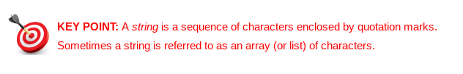
Strings
The individual symbols that make up a string are called Characters.
Characters can be letters, numbers, spaces, punctuation marks or any other symbol your keyboard will allow.

Slide 4
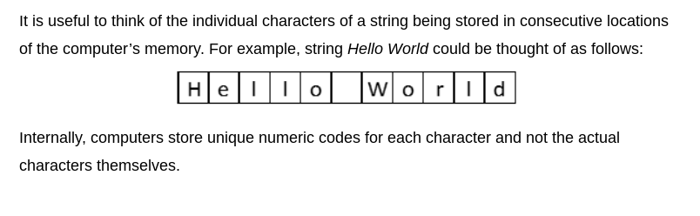
Strings

Slide 5
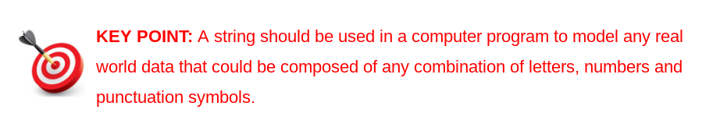
Strings

Slide 6
Strings
Examples of strings include names, addresses, passwords, email addresses, phone numbers, texts, facebook posts, tweets, product codes.
Note that data that looks numeric is frequently represented in programs by strings.
Apparent numbers can often contain non numeric data such as brackets, dashes or letters.
Common examples include phone ‘numbers’, vehicle registration ’numbers’ and PPS ‘numbers’.

Slide 7
String Operations
We already know that we can use the print command to display strings.
The most important string operations are indexing and slicing.
Indexing is a programming technique used to access individual characters of a string.
Slicing is a variation on this, used to access multiple continuous characters form a string. This is known as a sub string or a slice.

Slide 8

String Indexing
In order to understand string indexing and slicing, we must be able to understand the concept of an index.
Consider the following string
Internally, the computer represents the string s as a sequence of characters.
Each character is stored in its own separate memory location

Slide 9
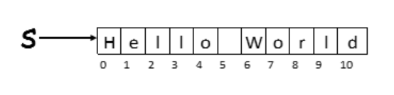
String Indexing
The individual characters in each Python string have a position.
The position is relative to the first character in the string and is known as an index.
The index of the first character itself, in every Python string, is always zero.

Slide 10
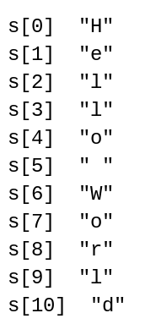
String Indexing
Each individual character in a string can be accessed by enclosing the characters index inside square brackets. The square brackets must appear directly after the string name
.

Slide 11
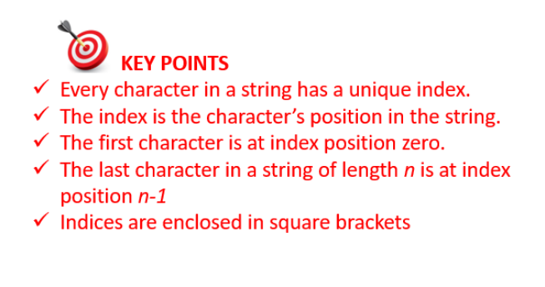
String Indexing

Slide 12
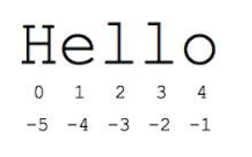
Negative Indices
Python permits the use of negative indices.
As can be seen on the string “Hello”, the last character can be accessed using the index -1.

Slide 13
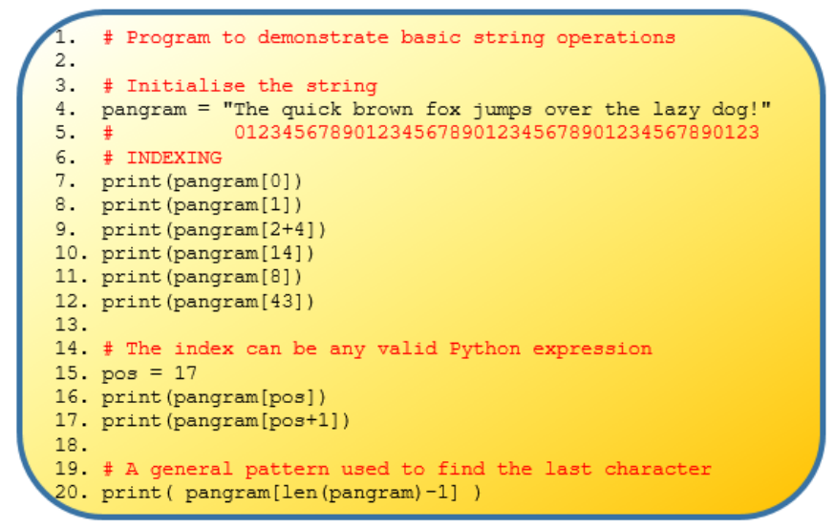

Slide 14
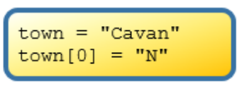
Common Pitfalls
It is important to note that strings are immutable.
This means that once a string is initialised it cannot be changed.
For this reason, it is not permitted to use the index operator ([ ]) on the left hand side of an assignment statement (=).
For example, Cavan could not be changed to Navan in the following way

Slide 15
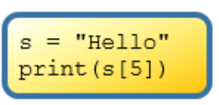
Common Pitfalls
If a program attempted to access a character in a string using an index that is too big (i.e. beyond the last character) for that string, Python returns a runtime error telling you that the index is out of range for that string.
Example:

Slide 16
String Slicing
The technique of indexing can also be used to extract a sub string from a string.
This is known as slicing and the part of the string that is extracted is known as the slice.
Slicing is useful when we want to extract a specific piece of information out of a longer piece of information.
In order to extract we need to know the indices of the slices start and end positions.

Slide 17
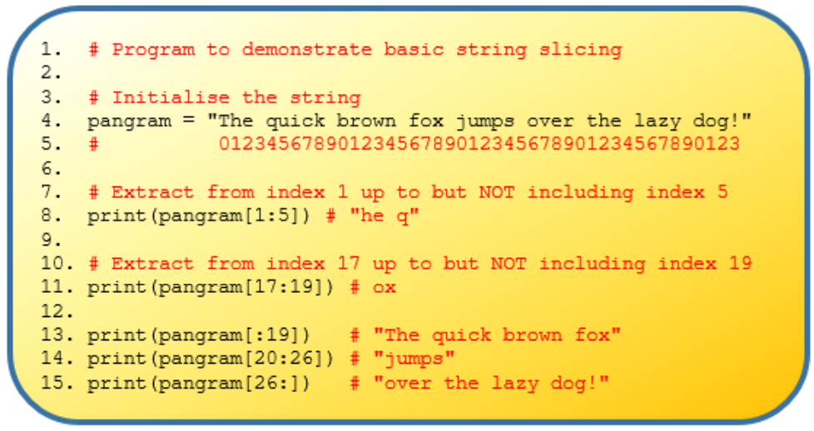

Slide 18
String Slicing
The colon delimits the start and end positions of the slice we want to extract.
The resulting slice runs from the starting index up to, but not including the end.
If the start is missing it is taken to be zero (first character).
If the end is missing it is taken as the index of the last character in the string.

Slide 19
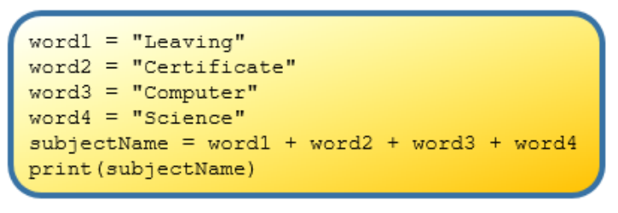
String Addition and Multiplication
Strings can be added and multiplied.
The operation of adding one string to another is referred to as string concatenation.
The plus operator is used to concatenate two strings.

Slide 20
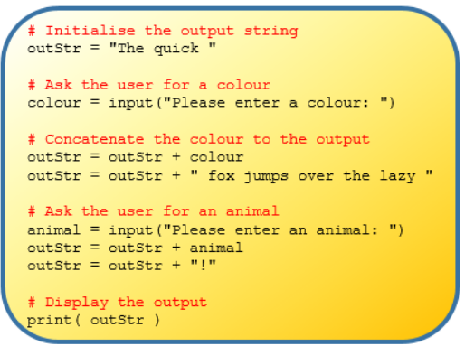
String Construction
String concatenation is useful for building up a string that is made up of strings from different sources.

Slide 21
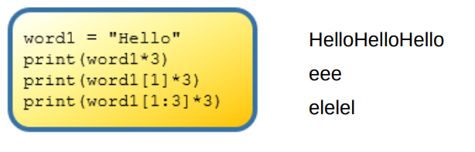
String Multiplication
When a string is multiplied by some integer, n, then a new string is produced.
The new string is the original string printed n times.

Slide 22
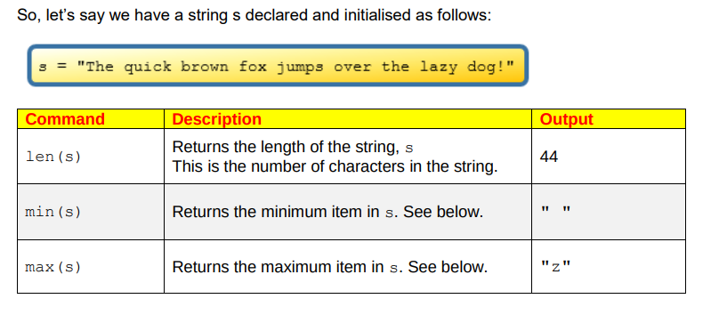
Built in String Commands

Slide 23
String Methods
String Methods are special commands that can be used to manipulate and perform useful operations on strings.
There are over 40 built in string commands, all found here
https://docs.python.org/3/library/stdtypes.html#string-methods
We are going to look at 5 of them.
Capitalize, upper, isupper, islower and find

Slide 24
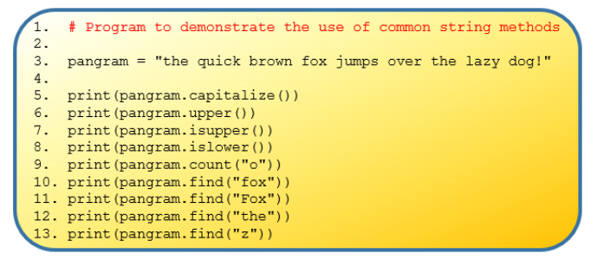

Slide 25
